Slide 1
导 师：金群华 教授
报告人: 马 龙
时 间：2017.11.28

Slide 2
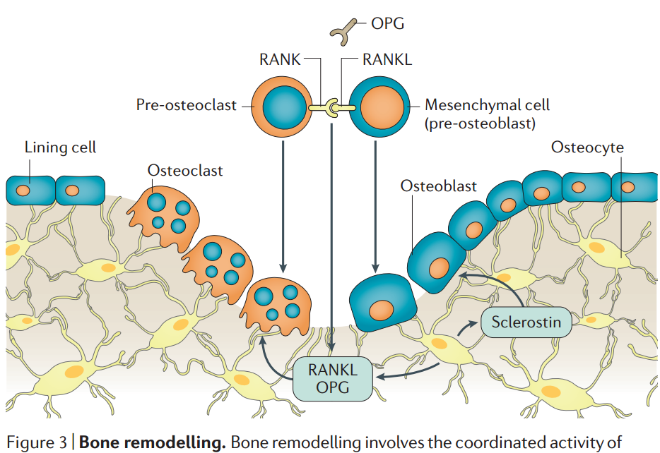
Introduction
These findings demonstrated that bone resorption is linked to bone formation by factors facilitating the transition from bone resorption to formation,so-called coupling factors.
Bone remodeling is a complicated process, in which osteoclasts and osteoblasts are involved. Currently, it has not been fully elucidated how osteocytes contribute to the coupling process between bone resorption and formation.

Slide 3
However, it remains to be clarified how bone resorption regulates the expression of sclerostin during bone remodeling.
oncostatin M (OSM) 制瘤素M; leukemia inhibitory factor (LIF) 白血病抑制因子; CT-1 心肌营养因子-1

Slide 4
Methods
In vivo experiments
WT mice
OPG–/– mice
RANKL-Tg mice
Trap staining
real-time RT-PCR
Immunohistochemistry
Immunofluorescence
ELISA
Bone histomorphometry：Calcein double labeling test
peripheral Quantitative Computed Tomography ，pQCT
In vitro experiments
UMR106 cells
Osteocyte-like cells
BMM-CM
Ocl-CM
real-time RT-PCR
Western blot
Antibody array analysis

Slide 5
1.Enhancement of Wnt/b-catenin signaling in OPG–/– mice 2.Downregulation of sclerostin expression in OPG–/– mice 3.Downregulation of sclerostin expression in RANKL-Tg mice 4.Osteoclast-derived factors suppress the expression of sclerostin 5.Osteoclast-derived LIF inhibits the expression of sclerostin 6.The effects of anti-RANKL antibody treatment on the expression of sclerostin 7.The effects of anti-RANKL antibody treatment on bone formation
Results

Slide 6
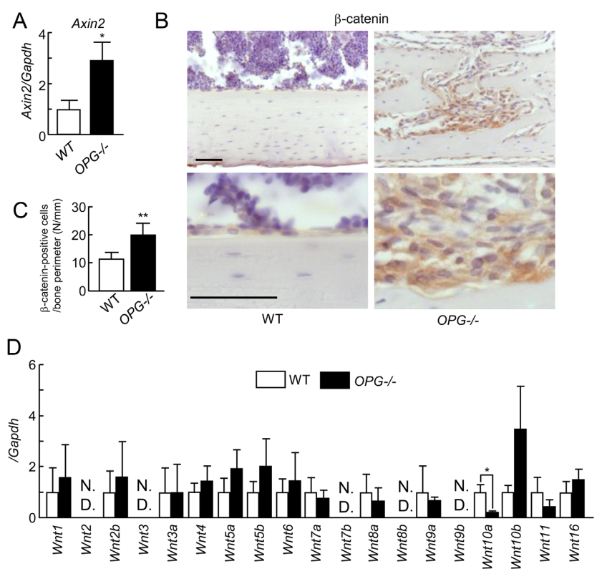
1.Enhancement of Wnt/b-catenin signaling in OPG–/– mice
Enhancement of Wnt/b-catenin signals in OPG–/– mice did not depend on the expression of Wnt ligands.
Fig. 1. Activation of Wnt/b-catenin signaling in OPG–/– mice.

Slide 7
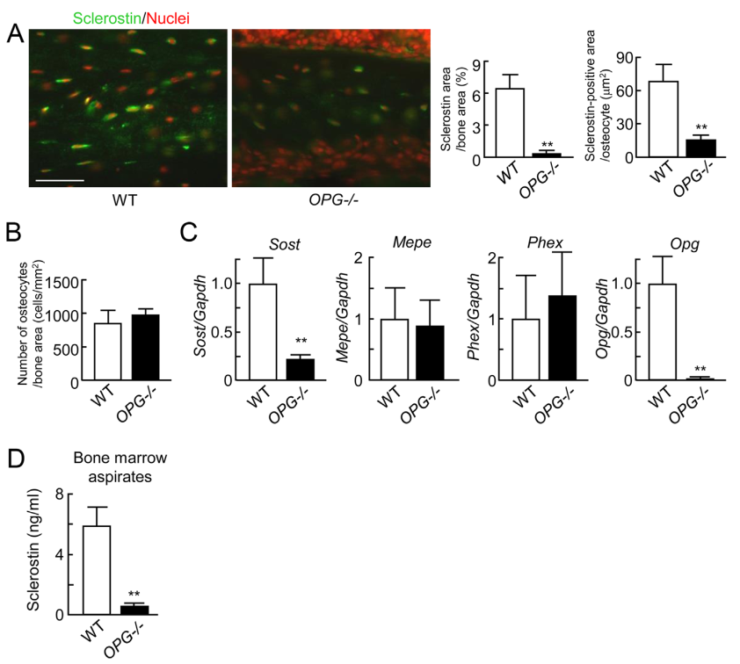
2.Downregulation of sclerostin expression in OPG–/– mice
These results suggested that the enhanced bone resorption may suppress the expression of sclerostin, which in turn promotes bone formation in OPG–/– mice.
骨细胞标记物，矿化相关蛋白
Mepe细胞外基质磷酸糖蛋白
Phex磷酸调节中性肽链内切酶
Fig. 2. Expression of sclerostin in OPG–/– mice.

Slide 8
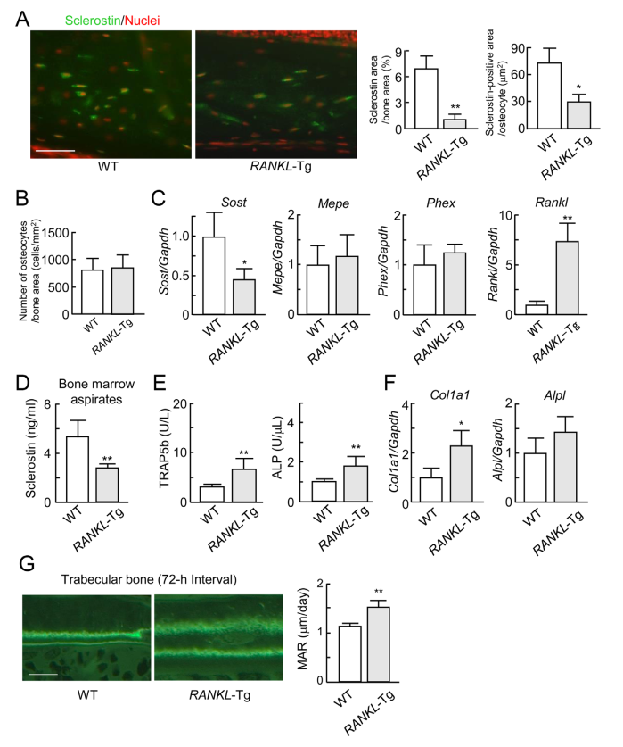
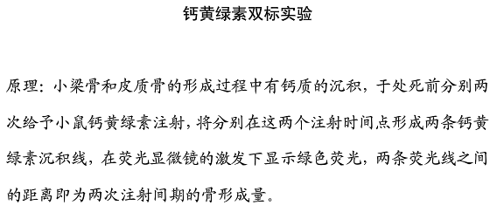
3.Downregulation of sclerostin expression in RANKL-Tg mice
These results strongly suggested thatthe state of bone resorption regulated the expression of sclerostin.
TRAP5b 抗 酒 石 酸 酸 性 磷 酸 酶 5b(骨吸收标记物)
Col1a1（编码I型胶原α1）
Alpl（编码ALP）
Fig. 3. Expression of sclerostin in RANKL-Tg mice.

Slide 10
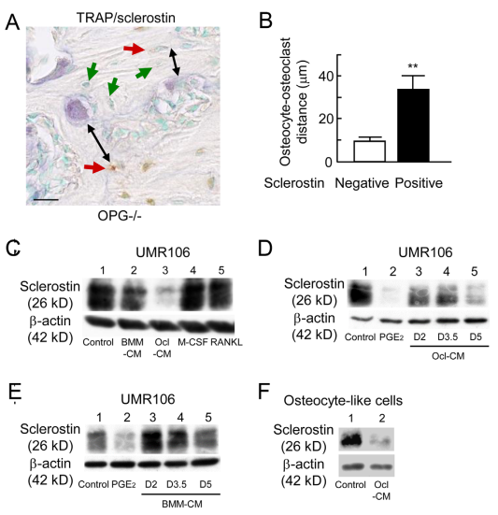
4.Osteoclast-derived factors suppress the expression of sclerostin
These results suggested that factors secreted from osteoclasts, but not RANKL, M-CSF suppressed the expression of sclerostin.
UMR106 cells 大鼠骨肉瘤细胞系
Fig. 4. Effects of osteoclast-derived factors on the expression of sclerostin

Slide 11
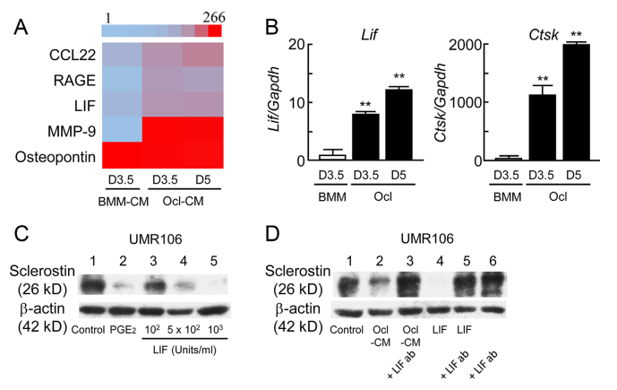
5.Osteoclast-derived LIF inhibits the expression of sclerostin
CCL22：趋化因子配体22
RAGE：晚期糖基化终产物
LIF：白血病抑制因子
Osteopontin：骨桥蛋白
Ctsk:组织蛋白酶K(破骨细胞功能相关分子)
抗体芯片是蛋白芯片的一种，具有微型化、集成化、高通量化的特点，可以用于检测某一特定的生理或病理过程相关蛋白的表达丰度，目前主要用于信号转导、蛋白质组学、肿瘤及其他疾病的相关研究。
原理：把能和不同抗原特异性结合的多种抗体高密度地固定到载体上，使待测样品通过芯片表面，经过洗脱把非特异性结合的蛋白洗掉，从而对特意性结合在上面的抗原进行检测
These results suggested that the osteoclast-derived LIF inhibited the expression of sclerostin in osteocytes
Fig. 5. Effects of osteoclast-derived LIF on the expression of sclerostin.

Slide 13
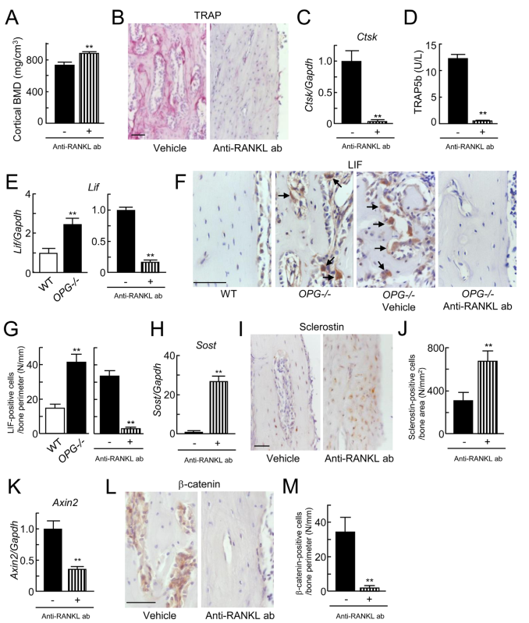
6.The effects of anti-RANKL antibody treatment on the expression of sclerostin
These findings suggested that treatment with the anti-RANKL antibody suppressed LIF expression, which in turn upregulated sclerostin expression, thereby decreasing Wnt/b-catenin signals.
Fig. 6.Effects of the anti-RANKL antibody on the expression of sclerostin in OPG–/– mice.

Slide 14
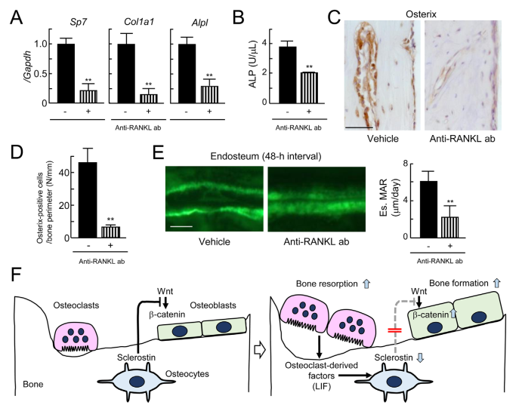
7.The effects of anti-RANKL antibody treatment on bone formation
These results suggested that treatment with the anti-RANKL antibody suppressed bone formation probably because of the increased expression of sclerostin.
Thus, the osteoclast-derived LIF suppresses the expression of sclerostin in osteocytes, thereby facilitating bone formation .
Sp7（编码osterix）
Col1a1（编码I型胶原α1）
Alpl（编码ALP）
Fig. 7. Effects of the anti-RANKL antibody on the bone formation in OPG–/– mice.

Slide 15
Discussion

Slide 16
Clinical studies reported that bone resorption contributes to bone turnover state and is associated with the serum level of sclerostin.
Roles of LIF in bone turnover were highlighted by bone phenotypes of LIF–/– mice

Slide 17
Therefore, it is unlikely that the changes in mechanical properties dominantly contribute to the suppression of sclerostin expression in those mice.Furthermore, the osteocytic lacunar-canalicular system was reportedly well arranged in the cortical bone of OPG–/– mice similar to that in WT mice.
Based on the previous and our present studies, the expression of sclerostin is not greatly affected by changes in the mechanical properties of bone with enhanced bone resorption in OPG–/– and RANKL-Tg mice.
Thus, osteoclastic suppression of sclerostin in osteocytes promotes bone formation through the activation of Wnt/b-catenin signals.
Based on previous and our present studies, administration of anti-resorbing agents with an anti-sclerostin antibody may effectively increase bone formation in osteoporosis.

Slide 18
Thank You

